Slide 1

Sentiment Analysis Using Word2Vec and Feedforward Neural Network
COSC-6339-002 Deep Learning Texas A&M University – Corpus Christi
By:
Manasa Kuchavaram
Shivani Jilukara
Thirumala Devi Kola
Sarika Gurram Sampath Reddy Kothakapu
Gowtham Krishna Sai Malina
Professor: Dr. Minhua Huang
Date: 11/26/24

Slide 2
Agenda
Introduction
Objectives
Dataset Overview
Preprocessing
Word2vec Embeddings
Feed Forward Neural Network Architecture
Training the neural network
Implementation of the code
Model Performance metric
Visualizing Sentiment Predictions
Comparison with Traditional Methods
Real World Applications
Future Scope
Conclusion

Slide 3

Introduction
What is Sentiment Analysis?
A technique in Natural Language Processing (NLP) used to determine whether a text expresses a positive or negative opinion.
Project Overview:
Build a sentiment classifier using Word2Vec embeddings and a Feedforward Neural Network (FFNN).
Transform raw text data into meaningful representations for accurate sentiment classification.
Applications:
Analyzing customer reviews, tracking brand sentiment, monitoring social media opinions, etc.

Slide 4

Objectives
Project Goals:
Preprocess raw text data to remove noise and extract meaningful content.
Use pre-trained Word2Vec embeddings to create dense numerical representations of words.
Design and train an FFNN model to classify text sentiment (positive/negative).
Evaluate the model’s performance using metrics like accuracy, precision, recall, and F1-score.
Outcome:
Develop a robust sentiment analysis pipeline with competitive accuracy and minimal overfitting.

Slide 5
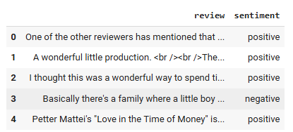
Dataset Overview
Description of the Dataset:
Text reviews with binary sentiment labels (positive/negative).
Each data entry consists of:
Review: The text expressing user opinion.
Sentiment: A label indicating positive or negative sentiment.
Dataset Statistics:
Number of reviews: 50001

Slide 6
Preprocessing
Raw Text: Input example - "The movie was AMAZING!!! 10/10 http://example.com"
Lowercasing: Example - "the movie was amazing!!! 10/10 http://example.com"
Remove Noise (URLs, special characters): Example - "the movie was amazing 10 10"
Remove Stopwords: Example - "movie amazing 10 10"
Lemmatization: Example - "movie amazing 10"
Final Cleaned Text: Example - "movie amazing"
Purpose:
Clean and standardize raw text data for consistent and effective model input.
Steps Involved:
Removing Noise:
Eliminate special characters, punctuation, and stopwords.
Standardizing Text:
Convert text to lowercase for uniformity.
Tokenization:
Split sentences into individual words.
Lemmatization:
Reduce words to their base forms (e.g., "running" → "run").
Outcome:
Produce clean, tokenized, and lemmatized text suitable for embedding generation.

Slide 7
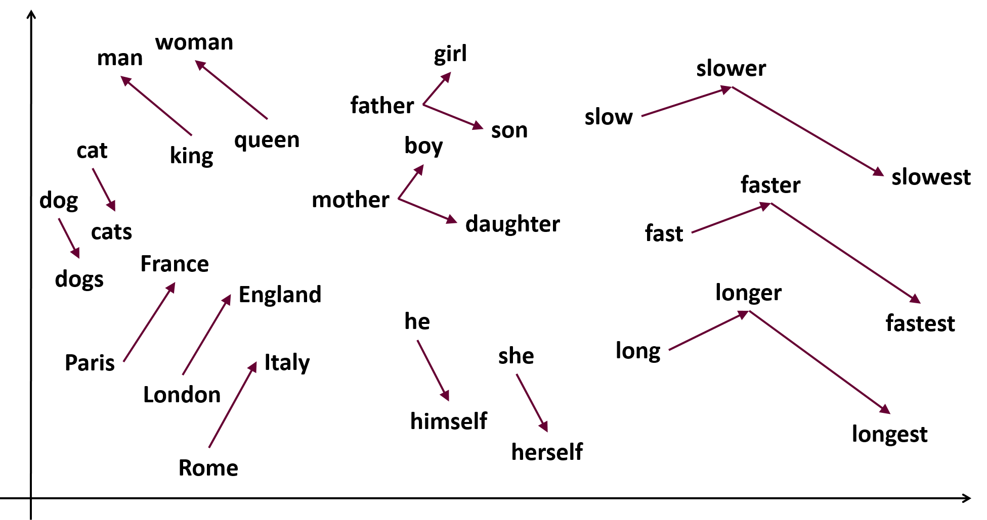
Word2Vec Embeddings
What is Word2Vec?
A technique that converts words into dense numerical vectors by learning word relationships from large text corpora.
Why Word2Vec?
Captures semantic meaning and context.
Represents words as 300-dimensional vectors.
Our Approach:
Used pre-trained Word2Vec embeddings (e.g., Google News) for efficiency.
Aggregated word embeddings in each review to form a single sentence vector (average pooling).

Slide 8
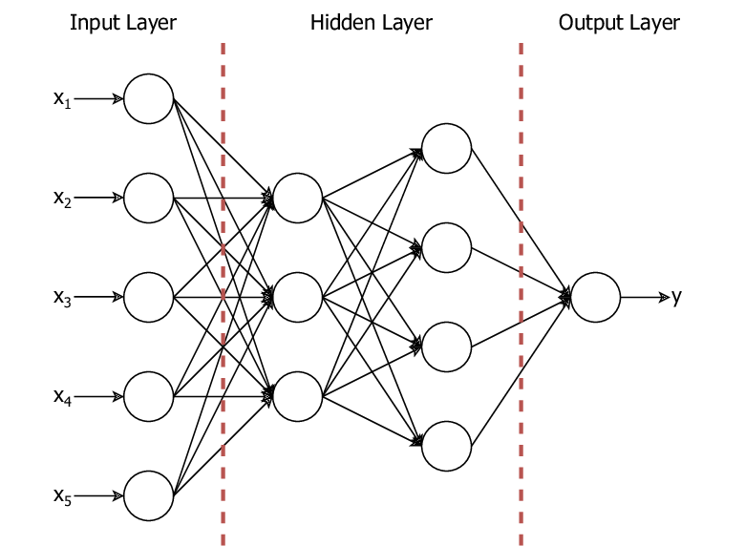
Feedforward Neural Network Architecture
What is a Feedforward Neural Network (FFNN)?
A type of deep learning model where data flows in one direction, from input to output.
Suitable for binary classification tasks, such as sentiment analysis.
Our Model Architecture:
Input Layer:
Accepts 300-dimensional Word2Vec embeddings as input.
Hidden Layers:
Two fully connected layers:
Layer 1: 128 neurons with ReLU activation.
Layer 2: 64 neurons with ReLU activation.
Output Layer:
Single neuron with Sigmoid activation to output a probability score (positive or negative sentiment).

Slide 9
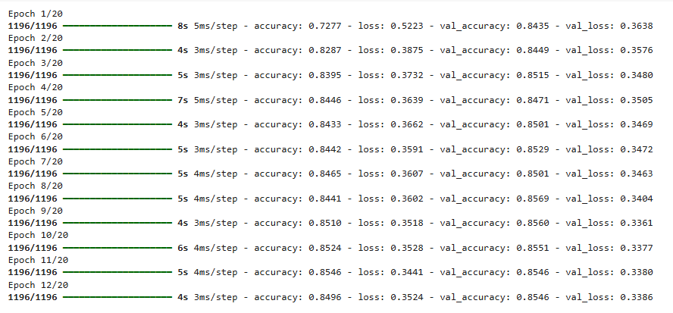
Training the Neural Network
Steps for Training:
Prepare the Data:
Split dataset into training, validation, and test sets.
Loss Function:
Binary Crossentropy: Measures the error between predicted probabilities and actual labels.
Optimizer:
Adam optimizer: Efficient gradient descent algorithm.
Early Stopping:
Monitored validation loss to stop training if no improvement was observed for 5 consecutive epochs.
Training Details:
Number of epochs: e.g., 20
Batch size: e.g., 32

Slide 10

Implementation of the Code
Redirecting to Google Colab
DLProject (1).ipynb - Colab

Slide 11
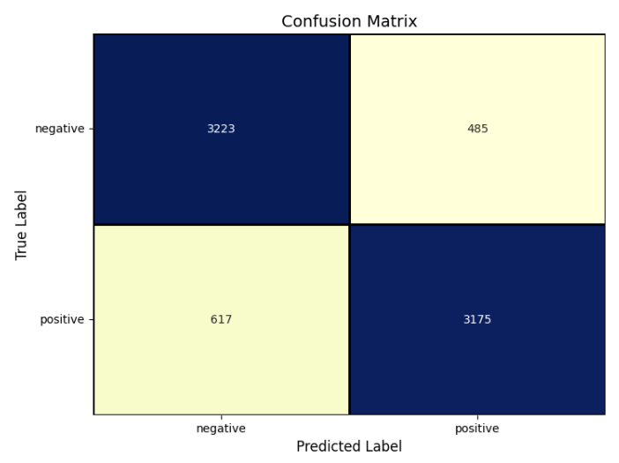
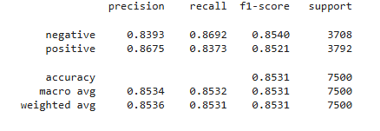
Model Performance Metrics
Evaluation Metrics:
Accuracy: 85%
Precision:
Negative: 83%
Positive: 86%
Recall:
Negative: 86%
Positive: 83%
F1-Score: Balanced at 85% for both classes.
Confusion Matrix Analysis:
True Negatives (TN): 3,223
False Positives (FP): 617
False Negatives (FN): 485
True Positives (TP): 3,175

Slide 12
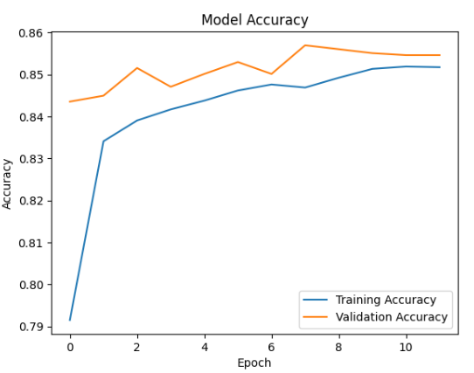
Accuracy Curves
Training vs Validation Accuracy:
Training accuracy steadily increased, reaching 85%.
Validation accuracy closely followed, indicating minimal overfitting.

Slide 13
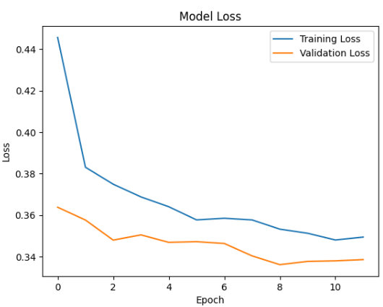
Loss Curves
Training vs Validation Loss:
Training loss decreased consistently.
Validation loss mirrored training loss, confirming good generalization.
Key Observations:
Consistent improvement across epochs.
No significant divergence between training and validation metrics.

Slide 14
Visualizing Sentiment Predictions
Prediction Examples:
Input Review 1: "The movie was amazing!" → Predicted Sentiment: Positive
Input Review 2: "The product did not meet expectations." → Predicted Sentiment: Negative
Confidence Scores:
Positive review: 0.92 (high confidence).
Negative review: 0.88 (high confidence).

Slide 15
Comparison with Traditional Methods
Traditional Approaches:
Bag-of-Words (BoW):
Treats text as a collection of words without considering word order.
High dimensionality and loss of semantic meaning.
TF-IDF:
Weighs words based on importance.
Captures some significance but ignores context and relationships.
Advantages of Word2Vec + FFNN:
Captures semantic relationships between words.
Fixed-size embeddings reduce dimensionality.
Neural network architecture enhances prediction power.

Slide 16
Challenges Faced
Data Preprocessing:
Embedding Conversion:
Model Design:
Resource Constraints:
Evaluation:
Interpretability:

Slide 17
Real-World Applications
Customer Feedback Analysis:
Monitor reviews to gauge customer satisfaction.
Social Media Monitoring:
Track public sentiment on trends or events.
Market Research:
Analyze consumer opinions for product development.
Healthcare:
Understand patient feedback to improve services.

Slide 18
Scope for Future Enhancements
Incorporate Contextual Embeddings:
Use BERT, GPT, or other transformer-based embeddings for deeper contextual understanding.
Explore Advanced Architectures:
Experiment with attention mechanisms or transformers for better sequential modeling.
Adapt to Multi-Class Sentiment Analysis:
Extend the model to classify sentiments like "positive," "neutral," and "negative.“
Domain Adaptation:
Fine-tune embeddings and models for specific industries like healthcare, retail, or finance.

Slide 19
Conclusions
Summary of Achievements:
Successfully implemented a sentiment analysis model using Word2Vec and FFNN.
Achieved 85% accuracy with balanced precision, recall, and F1-scores.
Demonstrated the effectiveness of embeddings for converting text into meaningful features.
Model Highlights:
Minimal overfitting observed during training.
Simple architecture, yet competitive performance.
Future Potential:
Opportunity to incorporate advanced NLP techniques and architectures.
Extend the model for domain-specific sentiment analysis applications.

Slide 20
Thank you !
Open to questions and feedback

